Slide 1
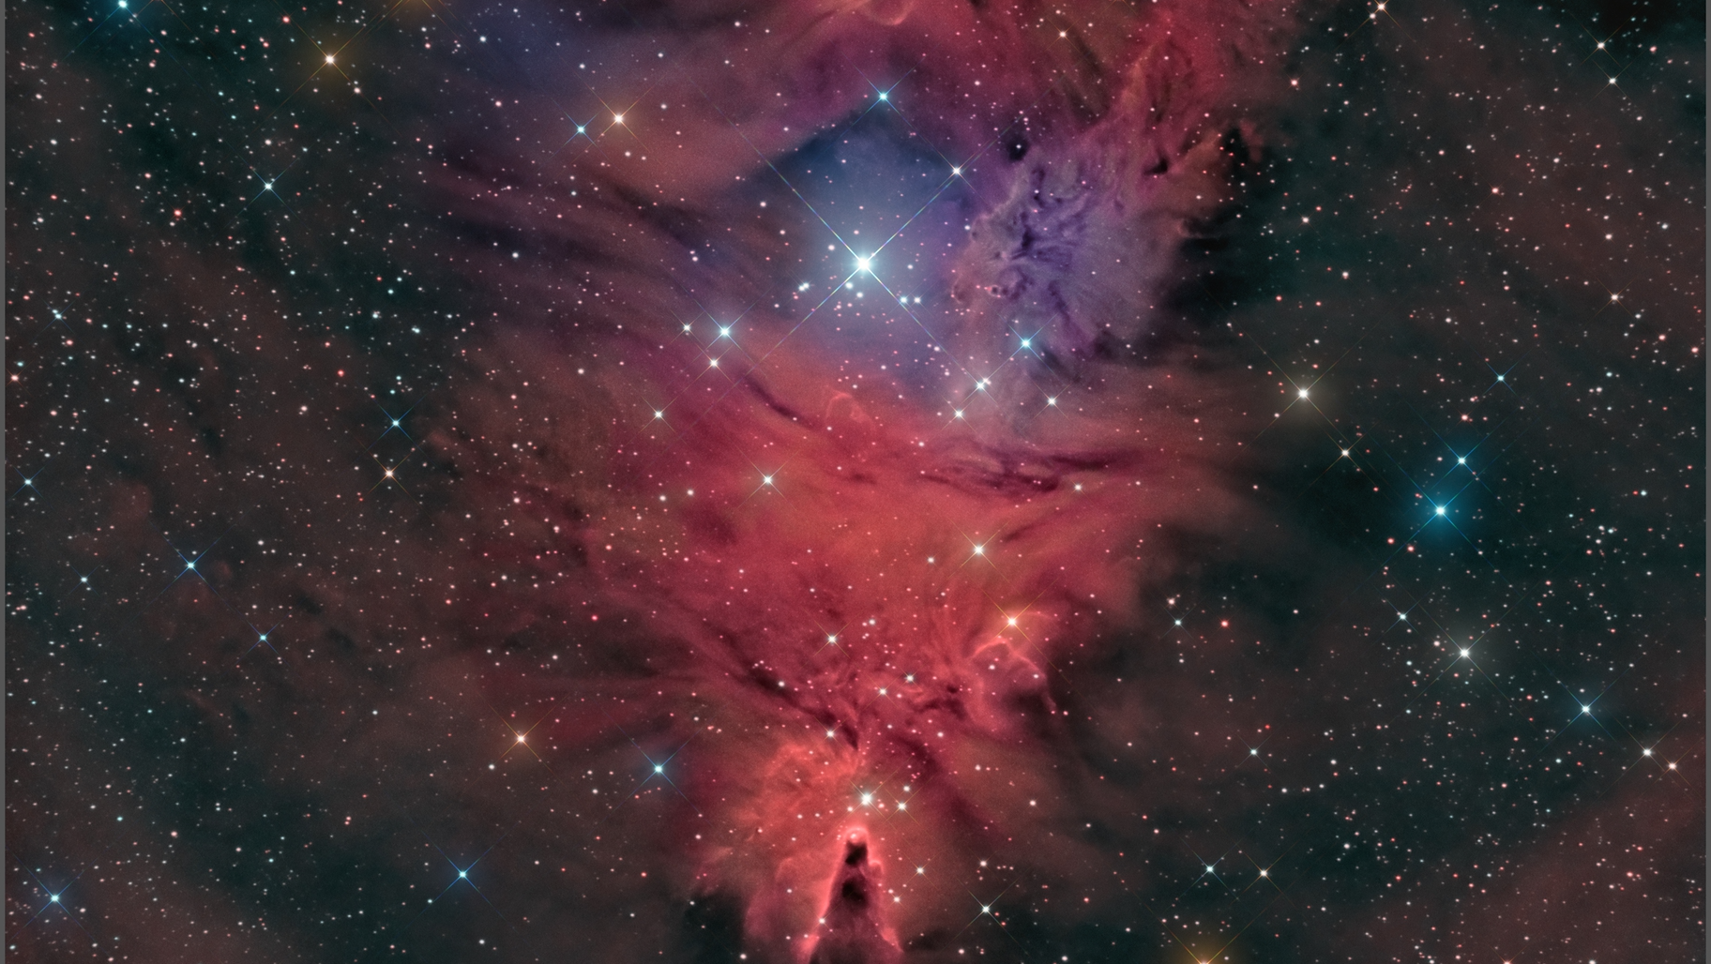
Finding roAp Candidates in open Cluster NGC 2264 using a Vectorized Mathematical Process
Principal Investigator: Jacob Romeo Research Advisor: Dr. Stephen Gillam

Slide 2

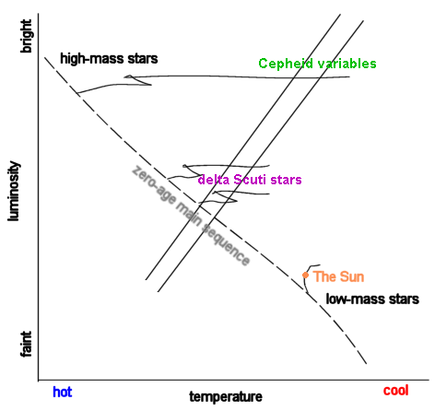
What’s an roAp?
roAp stands for rapidly oscillating Ap star.
Ap is the spectral type of the star for p stands for chemically peculiar, with Sr, Eu, Cr, and Si in their atmospheres.
These lie on the ∂-Scuti instability strip.
They are A - F class stars, about 1-2 solar masses​
EX: HD 134214, spectral type Ap SrEu(Cr), magnitude 7.46, period 5.6 minutes.

Slide 3
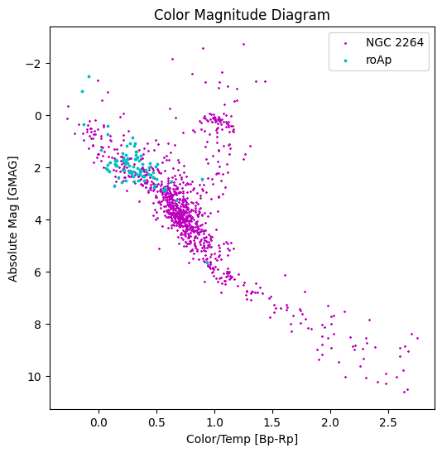
Background
Using a CMD as a method of classification.
The known roAps and cluster were cataloged using cone search with starhorse and Gaia in TopCat.
Starhorse being derived from Gaia EDR3.
Plotting the Absolute mag vs. Color of known roAps and chosen open cluster.

Slide 4
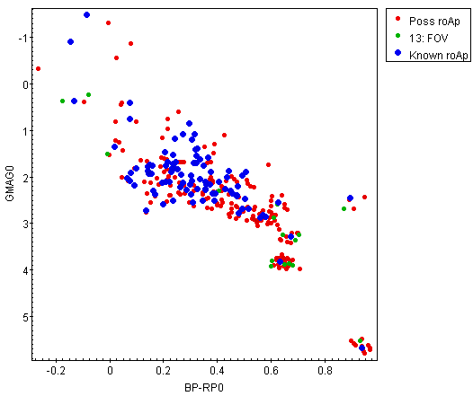
Initial Method
Using TopCat to plot the CMD.
Visually inspecting the cluster stars vs. the roAps.
Cataloging the cluster stars closest to the known roAps.

Slide 5
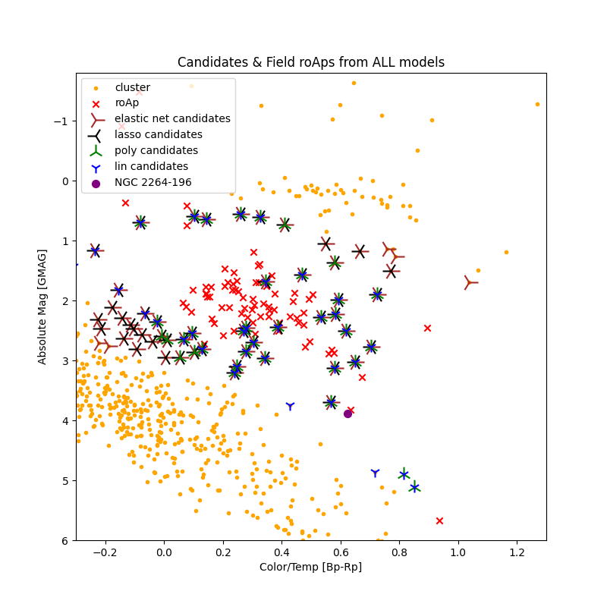
Regression Algorithm
Using Python’s matplotlib package to plot CMD.
Inspecting the cluster stars vs. the roAps using different regression techniques.
These included linear, polynomial, elastic, and lasso.
Cataloging the cluster stars closest to the known roAps’ regression slope from each technique.
Ranking strongest to weakest candidate, having 37 candidates from all 4 regressions.

Slide 6
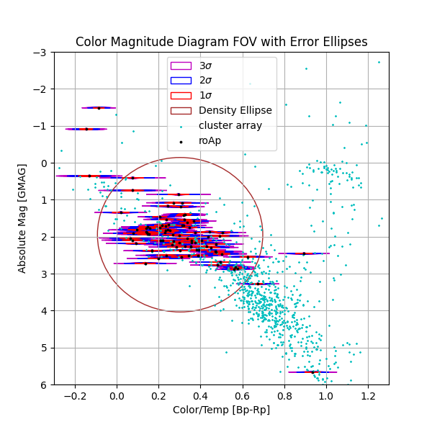
Current method
Using displacement and errors given by Gaia EDR 3 to calculate theoretical positions.
Displacement found by |GMAG - BP-RP|.
Errors are STDV of errors given by Gaia EDR3.
This implements errors from the cluster and roAps, vectorizing the array.
If theoretical pos < real pos then candidate.
Cataloging cluster stars which the vectorized algorithm chose based off given sigma.

Slide 7
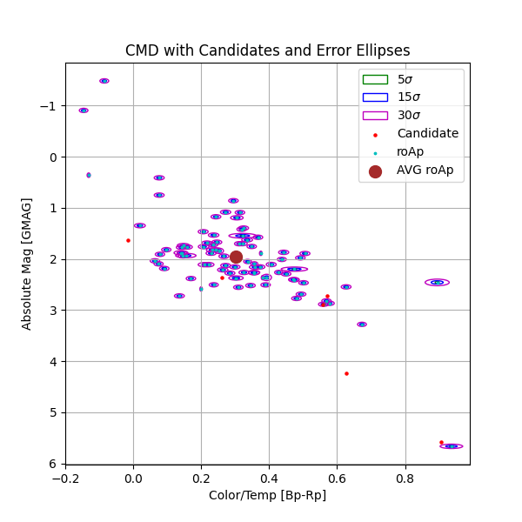
EXT. Current Method
Showing the candidates for the current algorithm.
Still needs a lot of work, currently doesn’t work right.

Slide 8
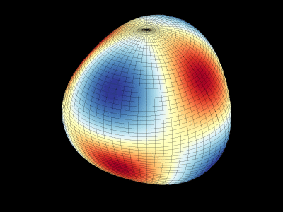
Future work
Allow for cone search with Gaia EDR 3 catalog in script.
Allow for more catalogs to be used, E.G. PANSTAARS, 2MASS, etc.
Implement more dependencies for a more selective algorithm.
E.G. Deriving more accurate error ellipses and using multiple filter selections.
Pursue observations of candidates.
Figure found online

